Slide 1

Application Layer Protocols
and
Services -6
Delivered By:
Avinash Bhagat
9463281930
avinash.bhagat@lpu.co.in
Copyright © The McGraw-Hill Companies, Inc. Permission required for reproduction or display.

Slide 2
Domain Name System (DNS) Chapter 25
TELNET Chapter 26
Simple Mail Transfer Protocol and Post Office Protocol Chapter 26
File Transfer Protocol Chapter 26
World Wide Web www Chapter27
Hyper text transfer Protocol HTTP Chapter27
Virtual Private Network (VPN) Chapter32
Firewalls Chapter32
Terminologies in Network Security Chapter30

Slide 3
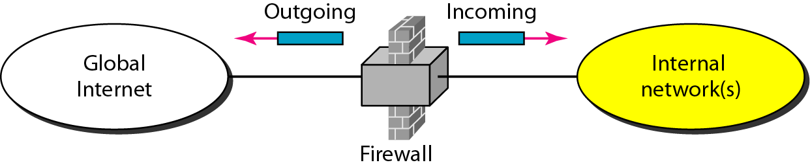
Firewalls
A firewall is a device installed between the internal network of an organization and the rest of the Internet. It is designed to forward some packets and filter (block) others.

Slide 4
Firewalls
A firewall is usually classified as a:
  packet-filter firewall
  proxy-based firewall.

Slide 5
A. Packet Filter Firewall
A firewall can be used as a packet filter.
forward or block packets based on the information in the:
    network layer
    and transport layer headers
Network Layer
    source and destination IP addresses,
    Type of protocol TCP or UDP
Transport Layer
    source and destination port addresses

Slide 6
A. Packet Filter Firewall
A packet-filter firewall filters packets at the network or transport layer.

Slide 7
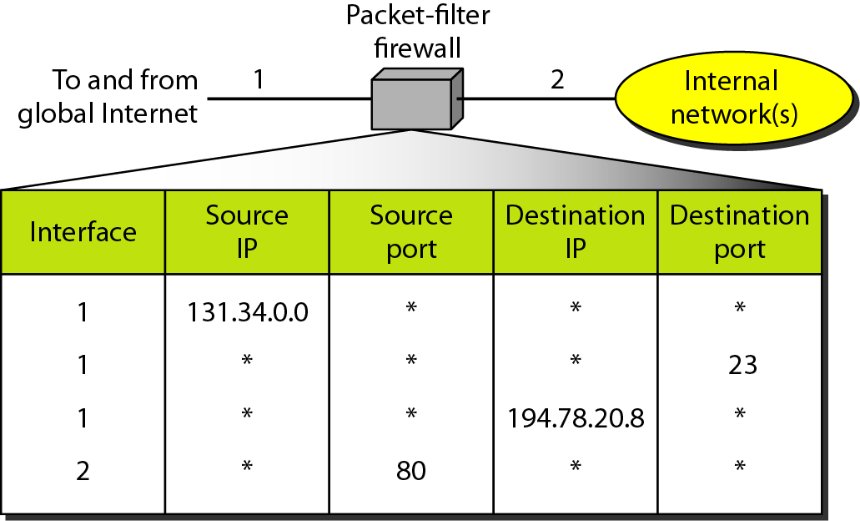
A. Packet Filter Firewall
Incoming packets from network 131.34.0.0 are blocked.

Slide 8
A. Packet Filter Firewall
Incoming packets destined for any internal TELNET server (port 23) are blocked.

Slide 9
A. Packet Filter Firewall
Incoming packets destined for internal host 194.78.20.8 are blocked. The organization wants this host for internal use only.

Slide 10
A. Packet Filter Firewall
Outgoing packets destined for an HTTP server (port 80) are blocked. The organization does not want employees to browse the Internet.

Slide 11
B. Proxy Firewall
sometimes we need to filter a message based on the information available in the message itself.
example, assume that an organization wants to implement the following policies regarding its Web pages:
Only those Internet users who have previously established business relations with the company can have access; access to other users must be blocked.
In this case, a packet-filter firewall is not feasible because it cannot distinguish between different packets arriving at TCP port 80 (HTTP). Testing must be done at the application level (using URLs).

Slide 12
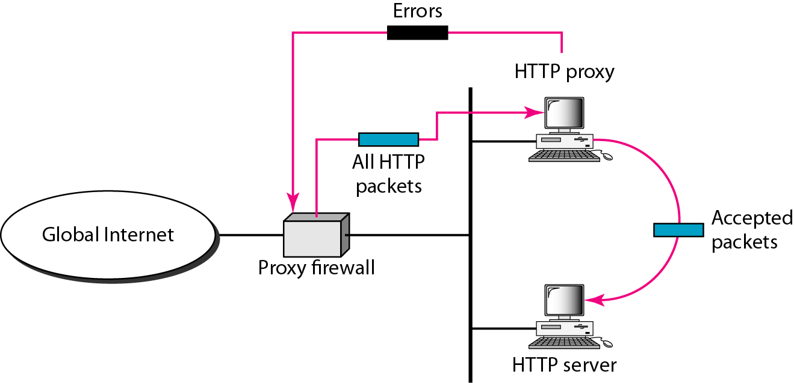
B. Proxy Firewall
When the user client process sends a message, the proxy firewall runs a server process to receive the request.
The server opens the packet at the application level and finds out if the request is legitimate.

Slide 13
B. Proxy Firewall
If it is legitimate., the server acts as a client process and sends the message to the real server.
If it is not legitimate. the message is dropped and an error message is sent to the external user.

Slide 14
A proxy firewall filters at the
application layer.

